Slide 1
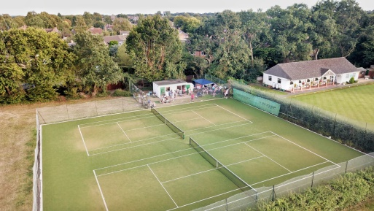
Flackwell Heath Tennis Club
The Straight Bit, Flackwell Heath, HP10 9LS
2024 Junior Tennis Camps, open to all Juniors!
Dates:
Monday 28 Oct
Tuesday 29 Oct
Wednesday 30 Oct
Thursday 31 Oct
Friday 1 Nov
Half Day 10:00-12:45 or 13:15-16:00
Full Day 10:00-16:00
Half Day | £22
1 Day | £37
2 Days | £68
3 Days | £95
4 Days | £120
5 Days | £140
Camps Include
Shot of the day, fun competitions, coaching and mini matches. Tuck Shop.
For Full Details, Call Justin: 07788 591778, E-mail: justincooktennis@live.co.uk or www.jctennis.co.uk
Please complete and send this booking form with payment to Justin Cook bank transfer Sort code: 20-40-71 account number: 30289302 ref players name: Justin Cook, 10 Consul Close, Woodley, Reading, RG5 4ET
----------------------------------------------------------------------------------------------
NAME(S):…………………………………................DOB:…………....................
ADDRESS……………………………………………………………..........................
EMERGENCY CONTACT…………………………….............................................
ANY MEDICAL CONDITIONS OR ALLERGIES………………………………......
Date | A.M or PM | Full Day
Monday 28 October
Tuesday 29 October
Wednesday 30 October
Thursday 31 October
Friday 1 November

