Slide 1



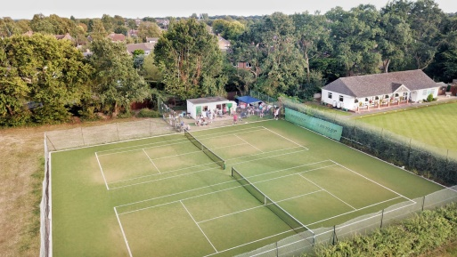
Flackwell Heath Tennis Club
The Straight Bit, Flackwell Heath, HP10 9LS
2026 Junior Tennis Camps, open to all Juniors!
Dates:
Monday 26 Oct
Tuesday 27 Oct
Wednesday 28 Oct
Thursday 29 Oct
Friday 30 0ct
Half Day 10:00-12:45 or 13:15-16:00
Full Day 10:00-16:00
Half Day | £25
1 Day | £37
2 Days | £68
3 Days | £95
4 Days | £120
5 Days | £140
Camps Include
Shot of the day, fun competitions, coaching and mini matches. Tuck shop.
For full details, call Justin: 07788 591778 or E-mail: justincooktennis@live.co.uk
Please complete and send this booking form with payment to Justin Cook bank transfer Sort code: 20-40-71 account number: 30289302 ref childs name. Justin Cook, 10 Consul Close, Woodley, Reading, RG5 4ET
----------------------------------------------------------------------------------------------
NAME(S):…………………………………................DOB:…………....................
ADDRESS……………………………………………………………..........................
EMERGENCY CONTACT…………………………….............................................
ANY MEDICAL CONDITIONS OR ALLERGIES………………………………......
Date | A.M or PM | Full Day
Monday 26 October
Tuesday 27 October
Wednesday 28 October
Thursday 29 October
Friday 30 October

